Slide 1
Fermat’s Theorem
Euler’s theorem
Primality Testing: Miller-Rabin algorithm
Euler’s totient (phi) function:ɵ(n)=p-1 * q-1

Slide 2
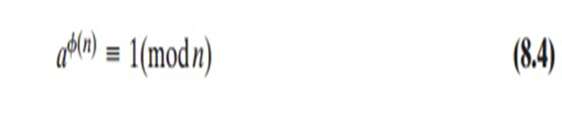
Euler’s Theorem:
Euler’s theorem states that for every a and n that are relatively prime:
Proof:
It is true if n is prime, because in that case, ϕ(n) = (n - 1) and Fermat’s theorem holds. However, it also holds for any integer n. Recall that f(n) is the number of positive integers less than n that are relatively prime to n. Consider the set of such integers, labelled as
R = {x1, x2, ...... , xϕ(n)}
That is, each element xi is a unique positive integer less than n with gcd(xi, n) = 1. Now multiply each element by a, modulo n:
S = {(ax1 mod n), (ax2 mod n), ....., (axϕ(n) mod n)}

Slide 3
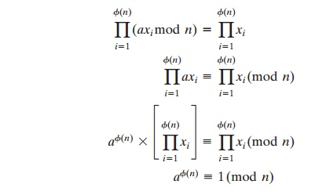
The set S is a permutation6 of R, by the following line of reasoning:
--Because a is relatively prime to n and xi is relatively prime to n, axi must also be relatively prime to n. Thus, all the members of S are integers that are less than n and that are relatively prime to n.
---There are no duplicates in S. Refer to Equation (4.5). If axi mod n = axj mod n, then xi = xj.
Therefore,

Slide 4
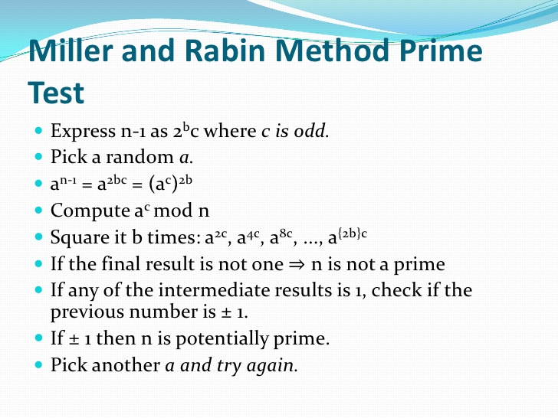

Slide 5
